Slide 1



ML/DL for Everyone with
Lecture 13: RNN II (classification)
Sung Kim <hunkim+ml@gmail.com> HKUST
Code: https://github.com/hunkim/PyTorchZeroToAll
Slides: http://bit.ly/PyTorchZeroAll

Slide 2

Call for Comments
Please feel free to add comments directly on these slides.
Other slides: http://bit.ly/PyTorchZeroAll
Picture from http://www.tssablog.org/archives/3280

Slide 3
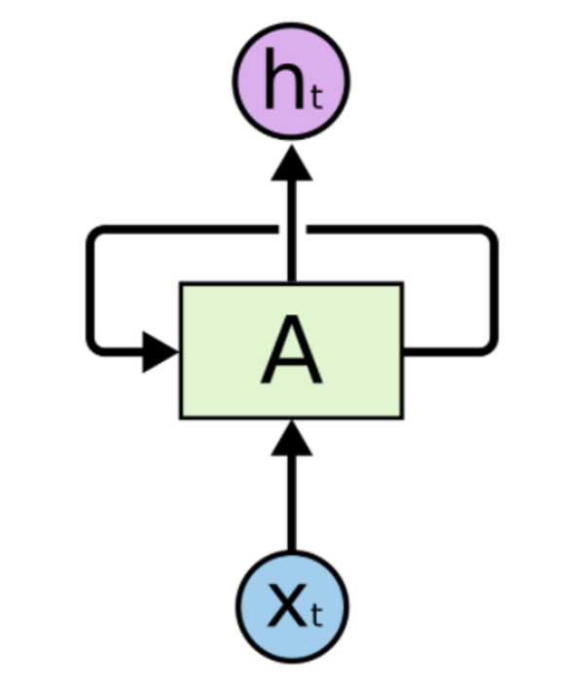
Typical RNN Models
Linear
P(y=0)
Embedding
(lookup table)
P(y=1)
…
P(y=n)
Loss
With CrossEntropy

Slide 4
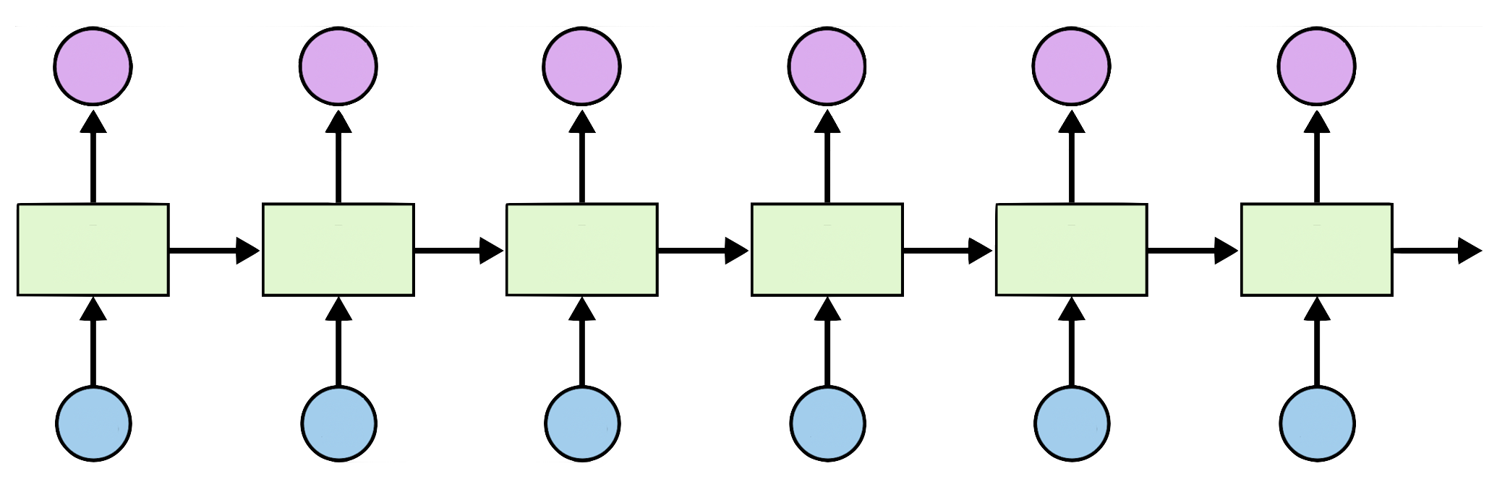
RNN Loss and training
l
l
l
l
l
l
[0.1, 0.6, 0.1, 0.1, 0.1]
h
i
h
e
l
l

Slide 5


RNN Applications
http://karpathy.github.io/2015/05/21/rnn-effectiveness/

Slide 6
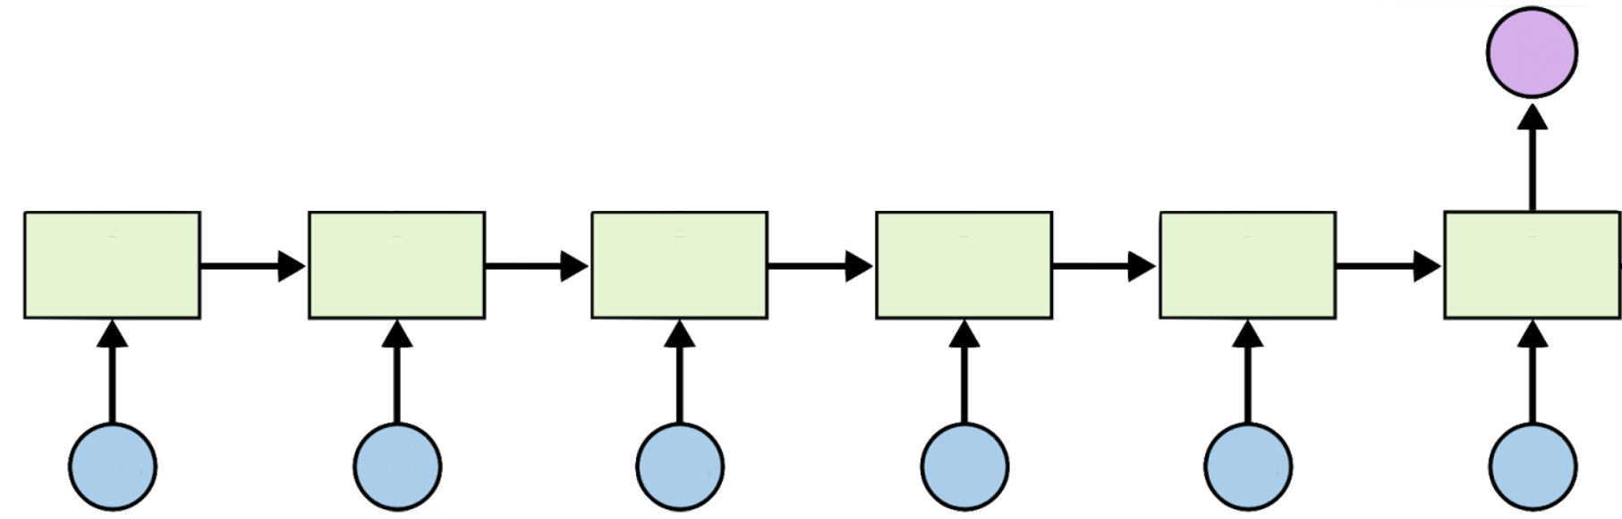
RNN Classification
http://karpathy.github.io/2015/05/21/rnn-effectiveness/

Slide 7
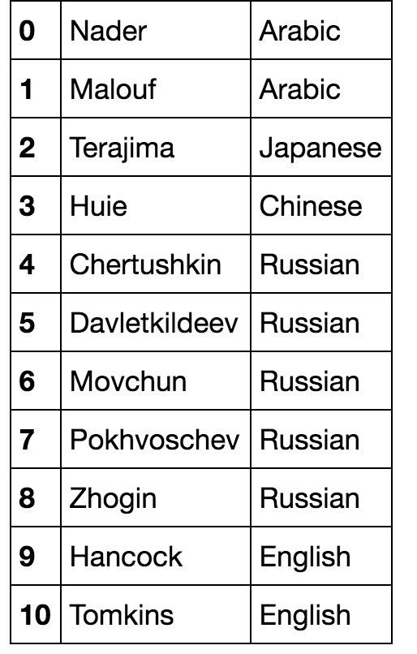
Name Classification: Dataset
Softmax output
(18 countries)
[ z h o g i n ]
https://github.com/hunkim/PyTorchZeroToAll

Slide 8
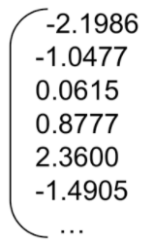
Char embedding
ASCII
(Index)
97
Embedding
(lookup table)
char, ‘a’

Slide 9
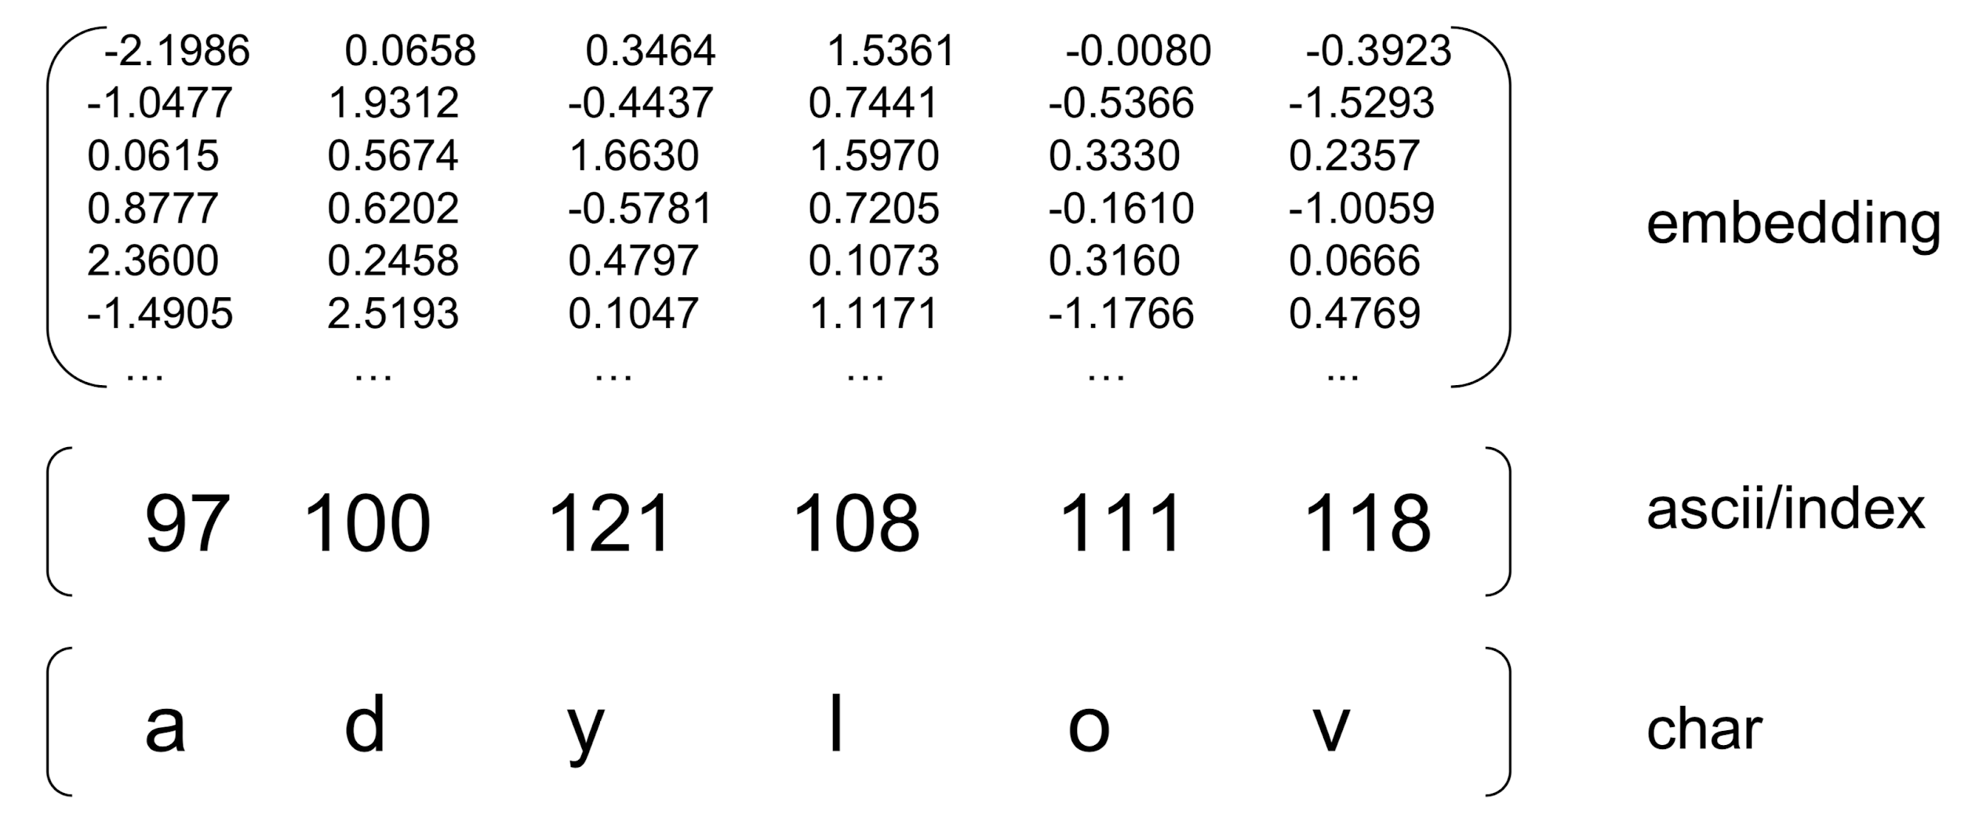

Input representation
Softmax output
(18 countries)
Matrix visualization from Nicolas, https://github.com/ngarneau

Slide 10
Input representation
Softmax output
(18 countries)
Matrix visualization from Nicolas, https://github.com/ngarneau

Slide 11
Input representation
Softmax output
(18 countries)
Matrix visualization from Nicolas, https://github.com/ngarneau

Slide 12
Data preparation
self.embedding =
nn.Embedding(input_voc_size, rnn_input_size)
...
embedded = self.embedding(input)
def str2ascii_arr(name):
arr = [ord(c) for c in name]
return arr, len(arr)
Matrix visualization from Nicolas, https://github.com/ngarneau

Slide 13
Implementation
class RNNClassifier(nn.Module):
def __init__(self, input_size, hidden_size, output_size, n_layers=1):
super(RNNClassifier, self).__init__()
self.hidden_size = hidden_size
self.n_layers = n_layers
self.embedding = nn.Embedding(input_size, hidden_size)
self.gru = nn.GRU(hidden_size, hidden_size, n_layers)
self.fc = nn.Linear(hidden_size, output_size)
def forward(self, input):
# Note: we run this all at once (over the whole input sequence)
# input = B x S . size(0) = B
batch_size = input.size(0)
# input: B x S -- (transpose) --> S x B
input = input.t()
# Embedding S x B -> S x B x I (embedding size)
print(" input", input.size())
embedded = self.embedding(input)
print(" embedding", embedded.size())
# Make a hidden
hidden = self._init_hidden(batch_size)
output, hidden = self.gru(embedded, hidden)
print(" gru hidden output", hidden.size())
# Use the last layer output as FC's input
# No need to unpack, since we are going to use hidden
fc_output = self.fc(hidden)
print(" fc output", fc_output.size())
return fc_output
def _init_hidden(self, batch_size):
hidden = torch.zeros(self.n_layers, batch_size, self.hidden_size)
return Variable(hidden)
if __name__ == '__main__':
classifier = RNNClassifier(N_CHARS,
HIDDEN_SIZE, N_CLASSES)
arr, _ = str2ascii_arr('adylov')
inp = Variable(torch.LongTensor([arr]))
out = classifier(inp)
print("in", inp.size(), "out", out.size())
# in torch.Size([1, 6])
#out torch.Size([1, 1, 18])

Slide 14
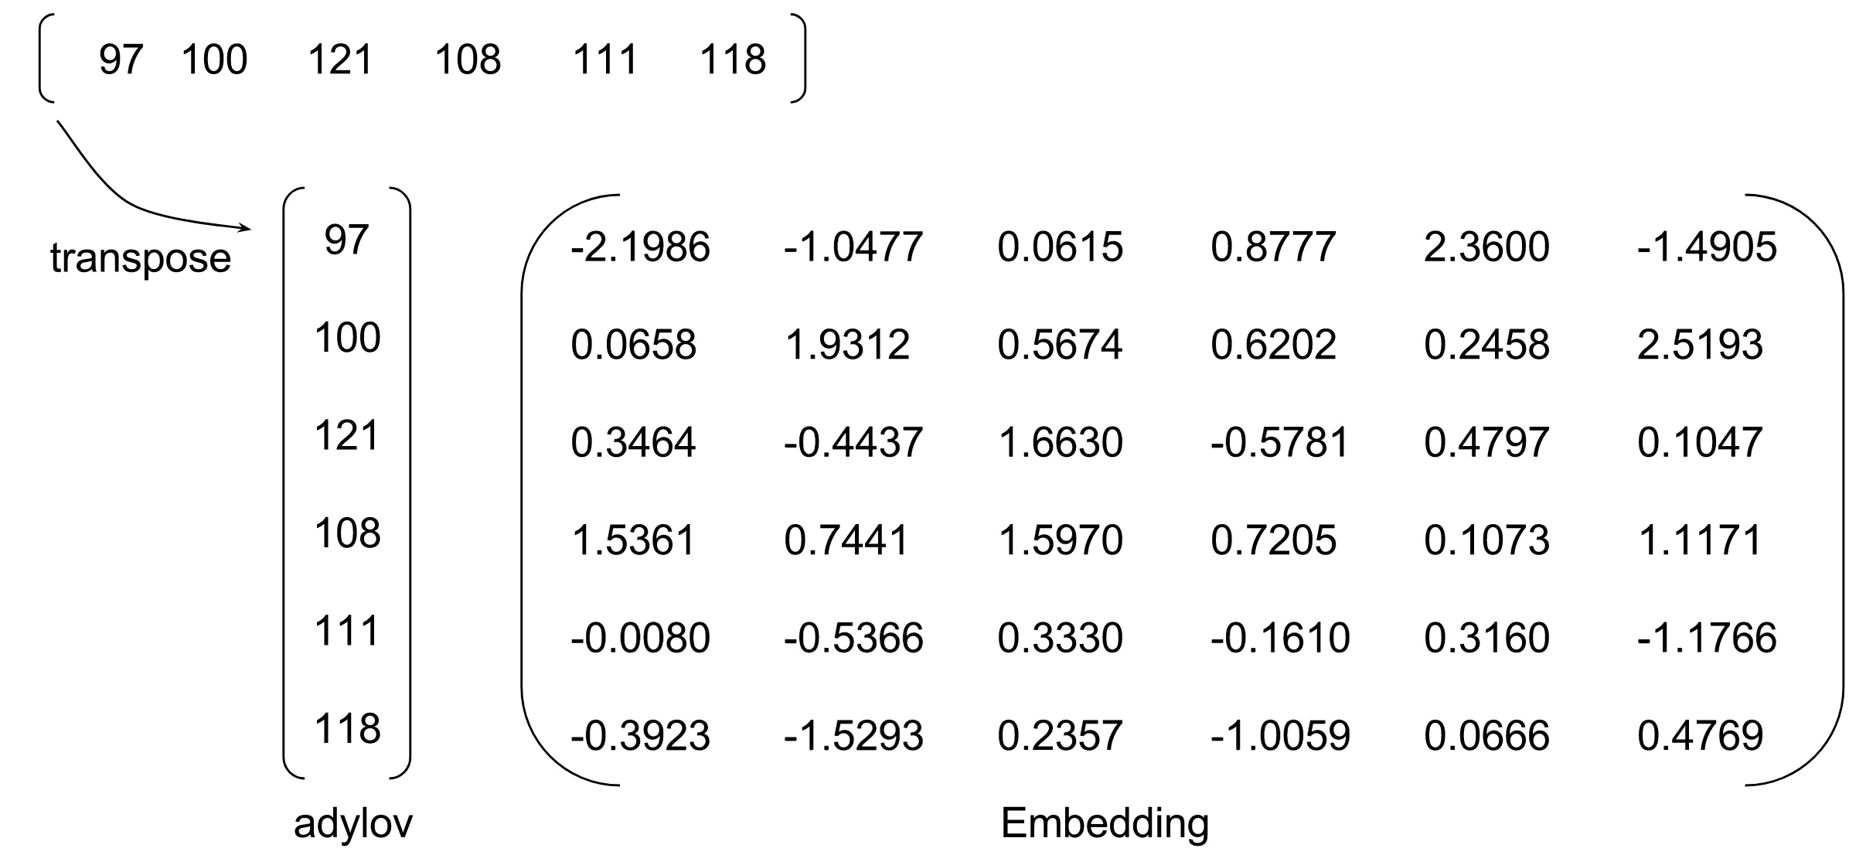
Implementation
class RNNClassifier(nn.Module):
def __init__(self, input_size, hidden_size, output_size, n_layers=1):
super(RNNClassifier, self).__init__()
self.hidden_size = hidden_size
self.n_layers = n_layers
self.embedding = nn.Embedding(input_size, hidden_size)
self.gru = nn.GRU(hidden_size, hidden_size, n_layers)
self.fc = nn.Linear(hidden_size, output_size)
def forward(self, input):
# Note: we run this all at once (over the whole input sequence)
# input = B x S . size(0) = B
batch_size = input.size(0)
# input: B x S -- (transpose) --> S x B
input = input.t()
# Embedding S x B -> S x B x I (embedding size)
print(" input", input.size())
embedded = self.embedding(input)
print(" embedding", embedded.size())
# Make a hidden
hidden = self._init_hidden(batch_size)
output, hidden = self.gru(embedded, hidden)
print(" gru hidden output", hidden.size())
# Use the last layer output as FC's input
# No need to unpack, since we are going to use hidden
fc_output = self.fc(hidden)
print(" fc output", fc_output.size())
return fc_output
def _init_hidden(self, batch_size):
hidden = torch.zeros(self.n_layers, batch_size, self.hidden_size)
return Variable(hidden)
if __name__ == '__main__':
classifier = RNNClassifier(N_CHARS,
HIDDEN_SIZE, N_CLASSES)
arr, _ = str2ascii_arr('adylov')
inp = Variable(torch.LongTensor([arr]))
out = classifier(inp)
print("in", inp.size(), "out", out.size())
# in torch.Size([1, 6])
#out torch.Size([1, 1, 18])

Slide 15
Batch?
if __name__ == '__main__':
names = ['adylov', 'solan', 'hard', 'san']
classifier = RNNClassifier(N_CHARS, HIDDEN_SIZE, N_CLASSES)
for name in names:
arr, _ = str2ascii_arr(name)
inp = Variable(torch.LongTensor([arr]))
out = classifier(inp)
print("in", inp.size(), "out", out.size())
# in torch.Size([1, 6]) out torch.Size([1, 1, 18])
# in torch.Size([1, 5]) out torch.Size([1, 1, 18]) # ...
if __name__ == '__main__':
classifier = RNNClassifier(N_CHARS,
HIDDEN_SIZE, N_CLASSES)
arr, _ = str2ascii_arr('adylov')
inp = Variable(torch.LongTensor([arr]))
out = classifier(inp)
print("in", inp.size(), "out", out.size())
# in torch.Size([1, 6])
#out torch.Size([1, 1, 18])

Slide 16
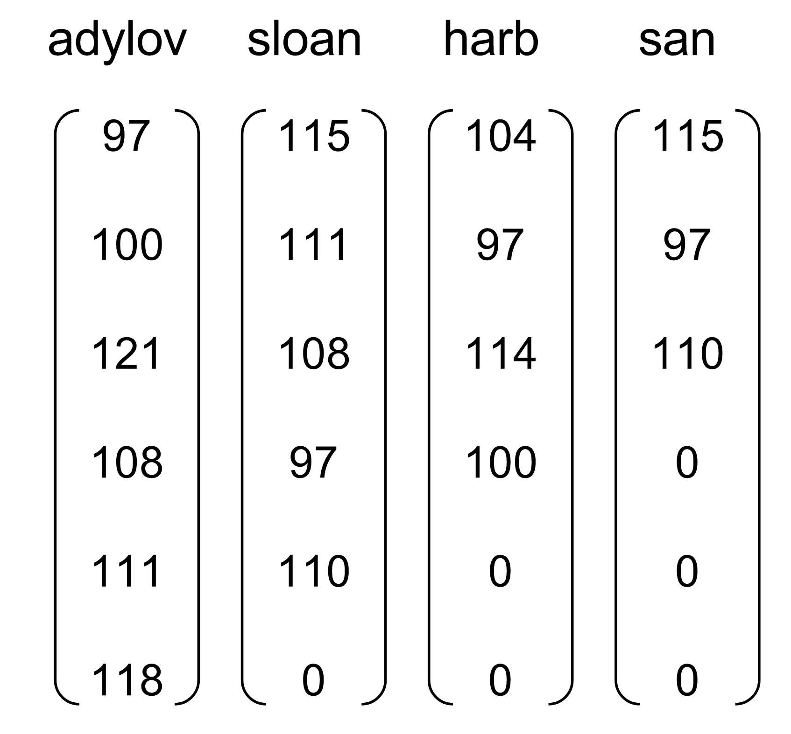
Batch?
if __name__ == '__main__':
names = ['adylov', 'solan', 'hard', 'san']
classifier = RNNClassifier(N_CHARS, HIDDEN_SIZE, N_CLASSES)
for name in names:
arr, _ = str2ascii_arr(name)
inp = Variable(torch.LongTensor([arr]))
out = classifier(inp)
print("in", inp.size(), "out", out.size())
# in torch.Size([1, 6]) out torch.Size([1, 1, 18])
# in torch.Size([1, 5]) out torch.Size([1, 1, 18]) # ...
if __name__ == '__main__':
classifier = RNNClassifier(N_CHARS,
HIDDEN_SIZE, N_CLASSES)
arr, _ = str2ascii_arr('adylov')
inp = Variable(torch.LongTensor([arr]))
out = classifier(inp)
print("in", inp.size(), "out", out.size())
# in torch.Size([1, 6])
#out torch.Size([1, 1, 18])

Slide 17
Zero padding

Slide 18
Zero padding

Slide 19
Zero padding
def pad_sequences(vectorized_seqs, seq_lengths):
seq_tensor = torch.zeros((len(vectorized_seqs), seq_lengths.max())).long()
for idx, (seq, seq_len) in enumerate(zip(vectorized_seqs, seq_lengths)):
seq_tensor[idx, :seq_len] = torch.LongTensor(seq)
return seq_tensor

Slide 20
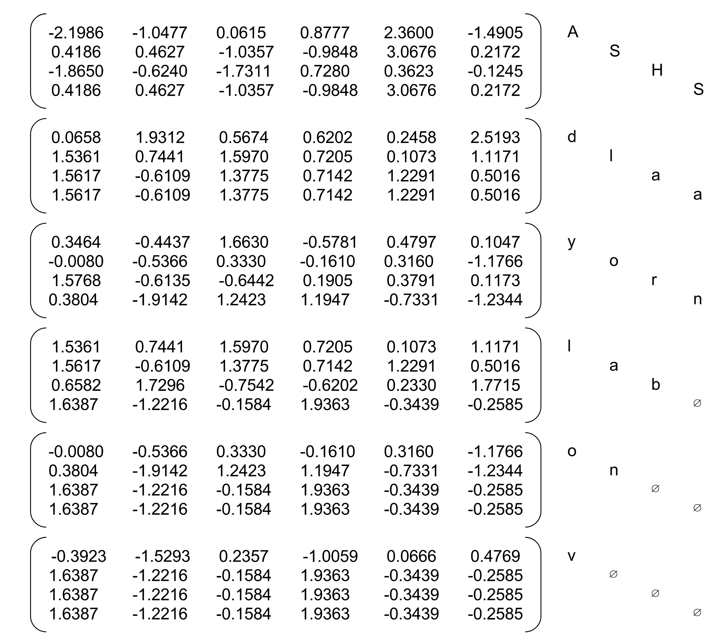
Embedding
# Embedding S x B -> S x B x I (embedding size)
embedded = self.embedding(input)

Slide 21
Full implementation
def str2ascii_arr(msg):
arr = [ord(c) for c in msg]
return arr, len(arr)
# pad sequences and sort the tensor
def pad_sequences(vectorized_seqs, seq_lengths):
seq_tensor = torch.zeros((len(vectorized_seqs), seq_lengths.max())).long()
for idx, (seq, seq_len) in enumerate(zip(vectorized_seqs, seq_lengths)):
seq_tensor[idx, :seq_len] = torch.LongTensor(seq)
return seq_tensor
# Create necessary variables, lengths, and target
def make_variables(names):
sequence_and_length = [str2ascii_arr(name) for name in names]
vectorized_seqs = [sl[0] for sl in sequence_and_length]
seq_lengths = torch.LongTensor([sl[1] for sl in sequence_and_length])
return pad_sequences(vectorized_seqs, seq_lengths)
if __name__ == '__main__':
names = ['adylov', 'solan', 'hard', 'san']
classifier = RNNClassifier(N_CHARS, HIDDEN_SIZE, N_CLASSES)
inputs = make_variables(names)
out = classifier(inp)
print("batch in", inp.size(), "batch out", out.size())
# batch in torch.Size([4, 6]) batch out torch.Size([1, 4, 18])

Slide 22
Full implementation
def str2ascii_arr(msg):
arr = [ord(c) for c in msg]
return arr, len(arr)
# pad sequences and sort the tensor
def pad_sequences(vectorized_seqs, seq_lengths):
seq_tensor = torch.zeros((len(vectorized_seqs), seq_lengths.max())).long()
for idx, (seq, seq_len) in enumerate(zip(vectorized_seqs, seq_lengths)):
seq_tensor[idx, :seq_len] = torch.LongTensor(seq)
return seq_tensor
# Create necessary variables, lengths, and target
def make_variables(names):
sequence_and_length = [str2ascii_arr(name) for name in names]
vectorized_seqs = [sl[0] for sl in sequence_and_length]
seq_lengths = torch.LongTensor([sl[1] for sl in sequence_and_length])
return pad_sequences(vectorized_seqs, seq_lengths)
if __name__ == '__main__':
names = ['adylov', 'solan', 'hard', 'san']
classifier = RNNClassifier(N_CHARS, HIDDEN_SIZE, N_CLASSES)
inputs = make_variables(names)
out = classifier(inputs)
print("batch in", inputs.size(), "batch out", out.size())
# batch in torch.Size([4, 6]) batch out torch.Size([1, 4, 18])
optimizer = torch.optim.Adam(classifier.parameters(),
lr=0.001)
criterion = nn.CrossEntropyLoss()
…
loss = criterion(output, target)
classifier.zero_grad()
loss.backward()
optimizer.step()

Slide 23
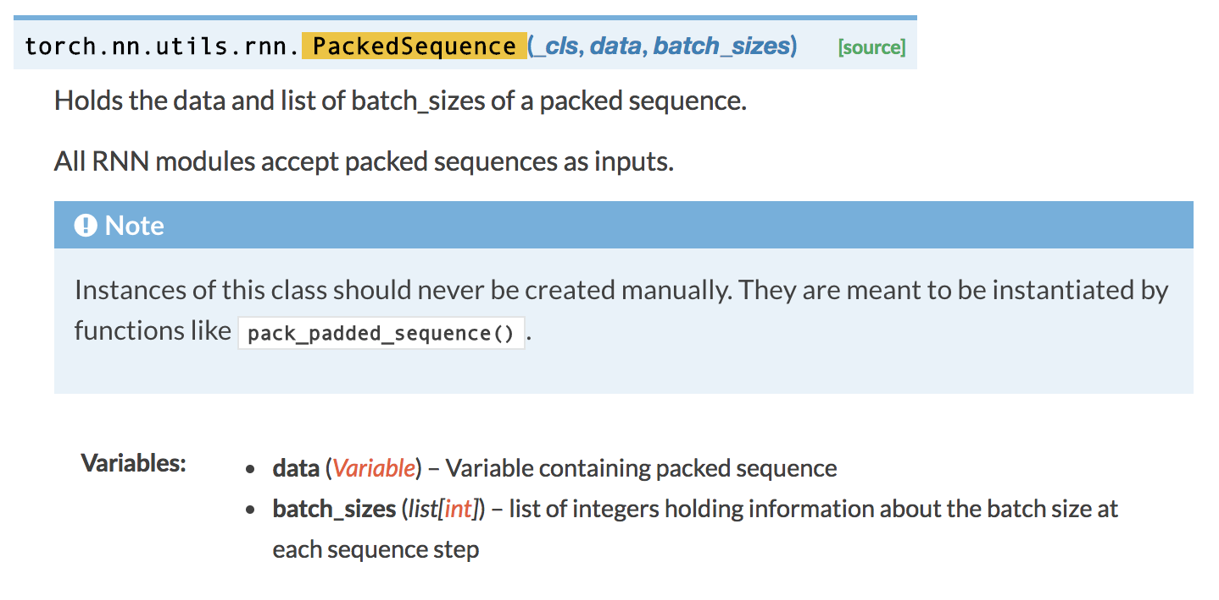
http://pytorch.org/docs/0.3.0/nn.html?highlight=packedsequence#torch.nn.utils.rnn.PackedSequence
Notes:
All RNN modules accept packed sequences as inputs.

Slide 24
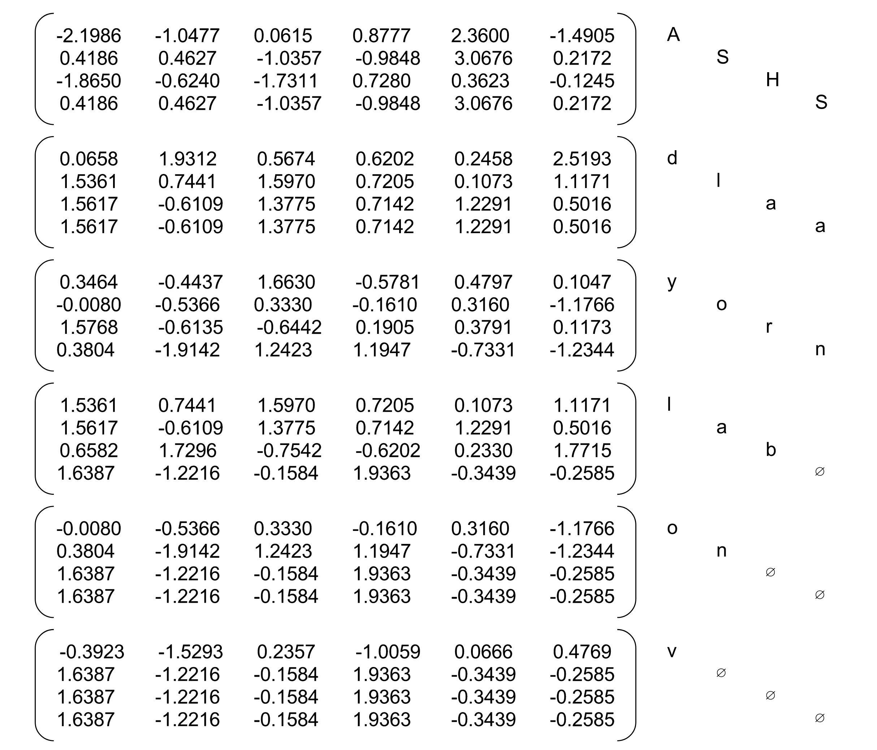
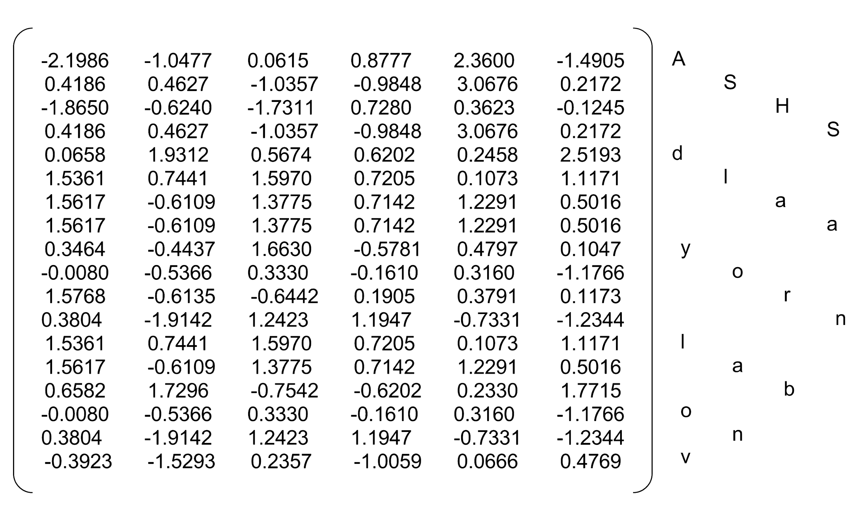
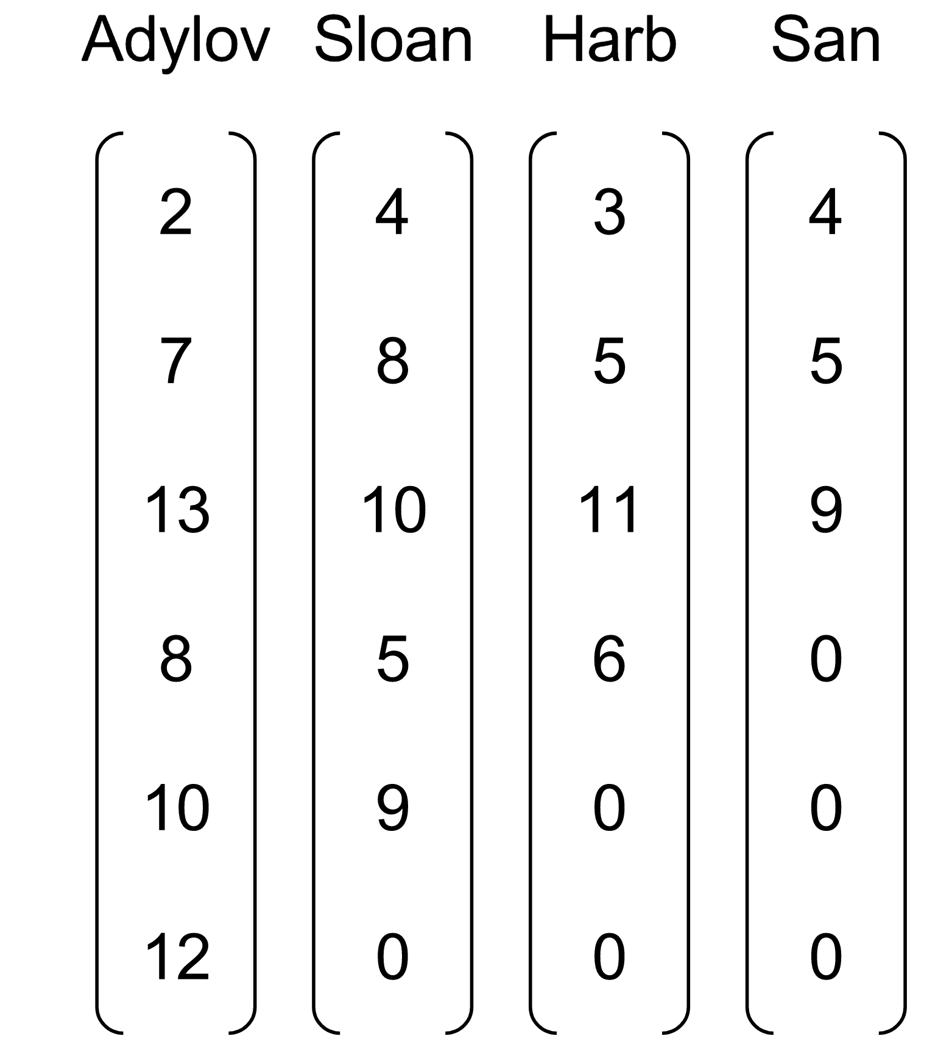
Efficiently handling batched sequences with variable lengths:
pack_padded_sequence
embedding
packing
RNN
Ordered batch
(by length)
https://github.com/hunkim/PyTorchZeroToAll/blob/master/13_4_pack_pad.py
Matrix visualization from Nicolas, https://github.com/ngarneau

Slide 25
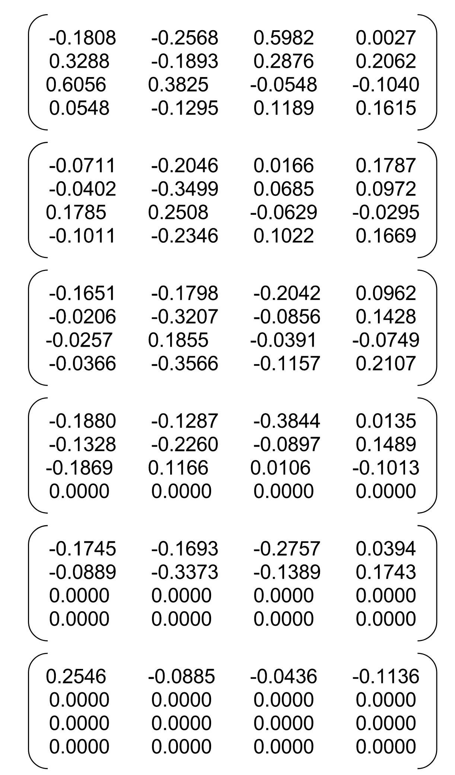
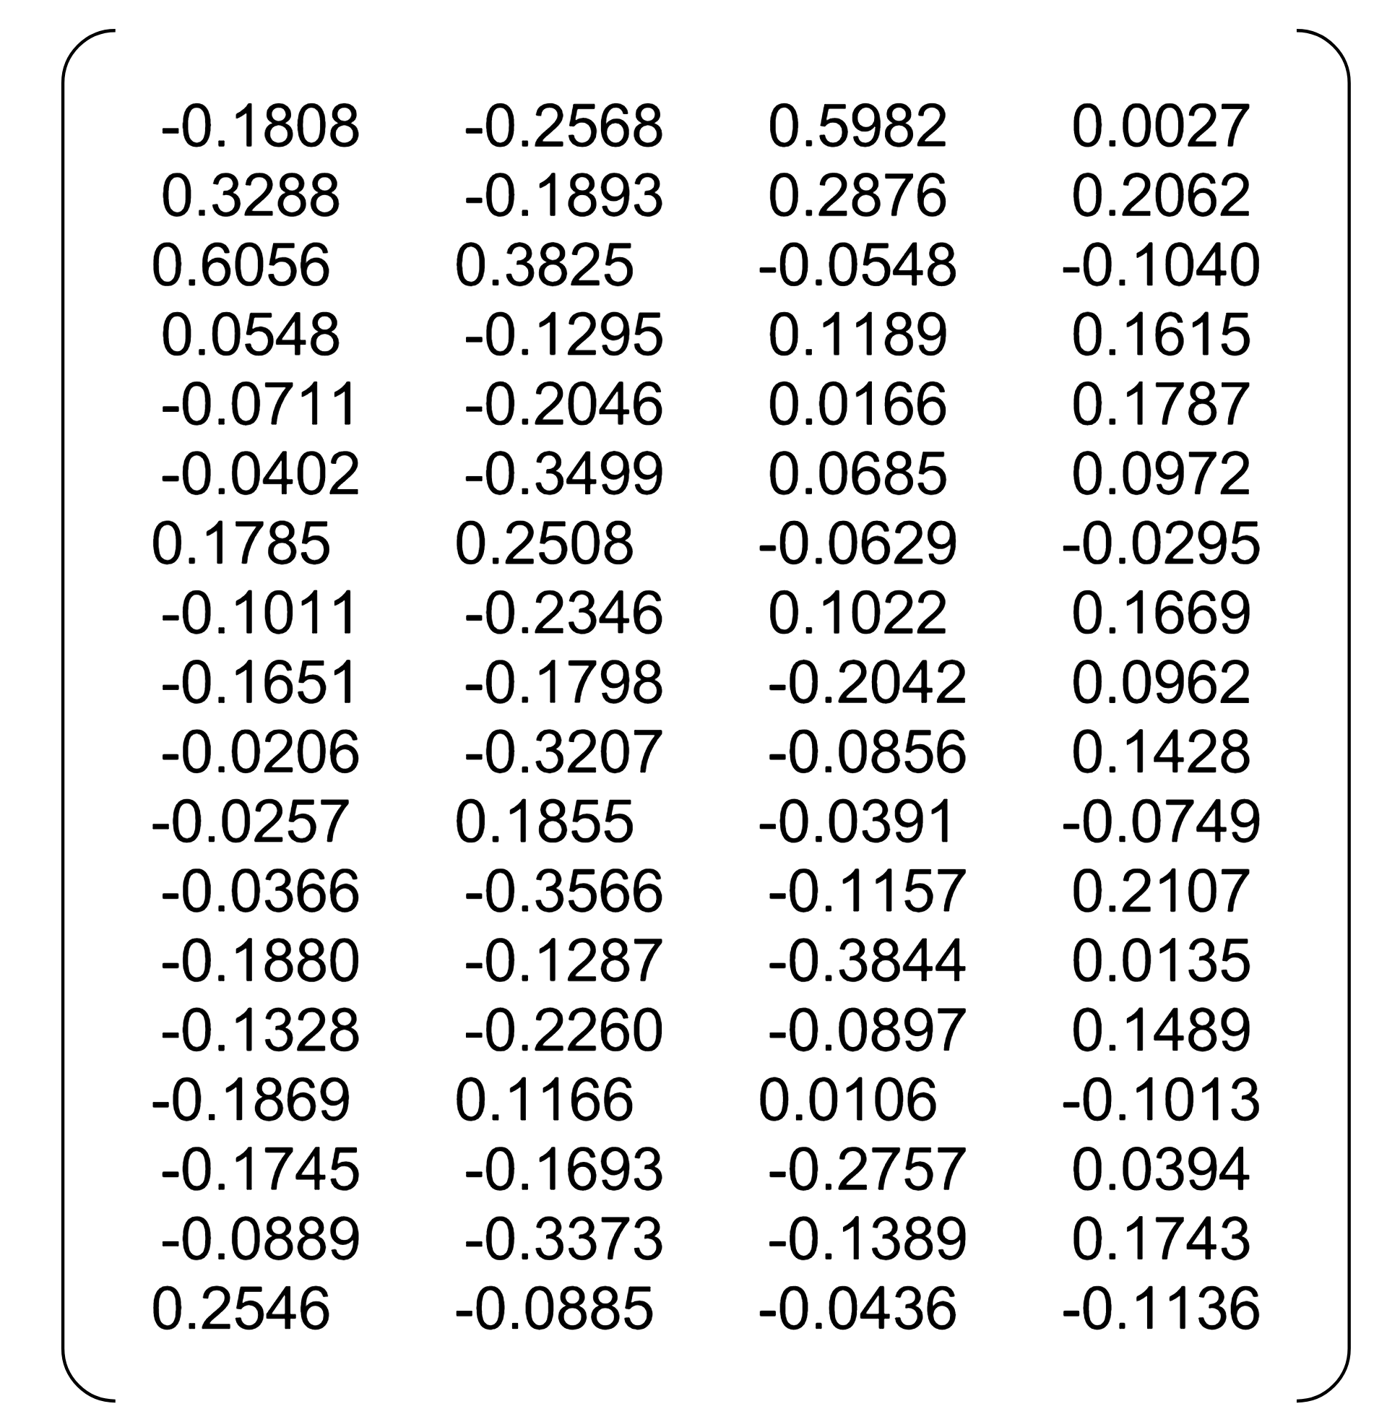
Efficiently handling batched sequences with variable lengths:
pack_padded_sequence
RNN
Out
unpack
https://github.com/hunkim/PyTorchZeroToAll/blob/master/13_4_pack_pad.py
Matrix visualization from Nicolas, https://github.com/ngarneau

Slide 26
Efficiently handling batched sequences with variable lengths:
pack_padded_sequence
(a) With packing and unpacking
https://github.com/hunkim/PyTorchZeroToAll/blob/master/13_4_pack_pad.py
Matrix visualization from Nicolas, https://github.com/ngarneau

Slide 27
Efficiently handling batched sequences with variable lengths:
pack_padded_sequence
(a) With packing and unpacking
(b) Without packing and unpacking
Matrix visualization from Nicolas, https://github.com/ngarneau

Slide 28
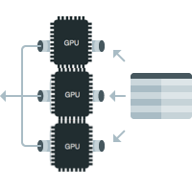


GPU/Data Parallel
Copy all variables to gpu
if torch.cuda.is_available():
return Variable(tensor.cuda())
else:
return Variable(tensor)
Put your models on gpu
classifier = RNNClassifier(N_CHARS, HIDDEN_SIZE, ...
if torch.cuda.is_available():
classifier.cuda()
http://pytorch.org/tutorials/beginner/blitz/data_parallel_tutorial.html#sphx-glr-beginner-blitz-data-parallel-tutorial-py

Slide 29

GPU/Data Parallel
Copy all variables to gpu
if torch.cuda.is_available():
return Variable(tensor.cuda())
else:
return Variable(tensor)
Put your models on gpu
classifier = RNNClassifier(N_CHARS, HIDDEN_SIZE, ...
if torch.cuda.is_available():
classifier.cuda()
Wrap your model using data parallel
if torch.cuda.device_count() > 1:
print("Let's use", torch.cuda.device_count(), "GPUs!")
# dim = 0 [33, xxx] -> [11, ...], [11, ...], [11, ...] on 3 GPUs
classifier = nn.DataParallel(classifier)
http://pytorch.org/tutorials/beginner/blitz/data_parallel_tutorial.html#sphx-glr-beginner-blitz-data-parallel-tutorial-py

Slide 30
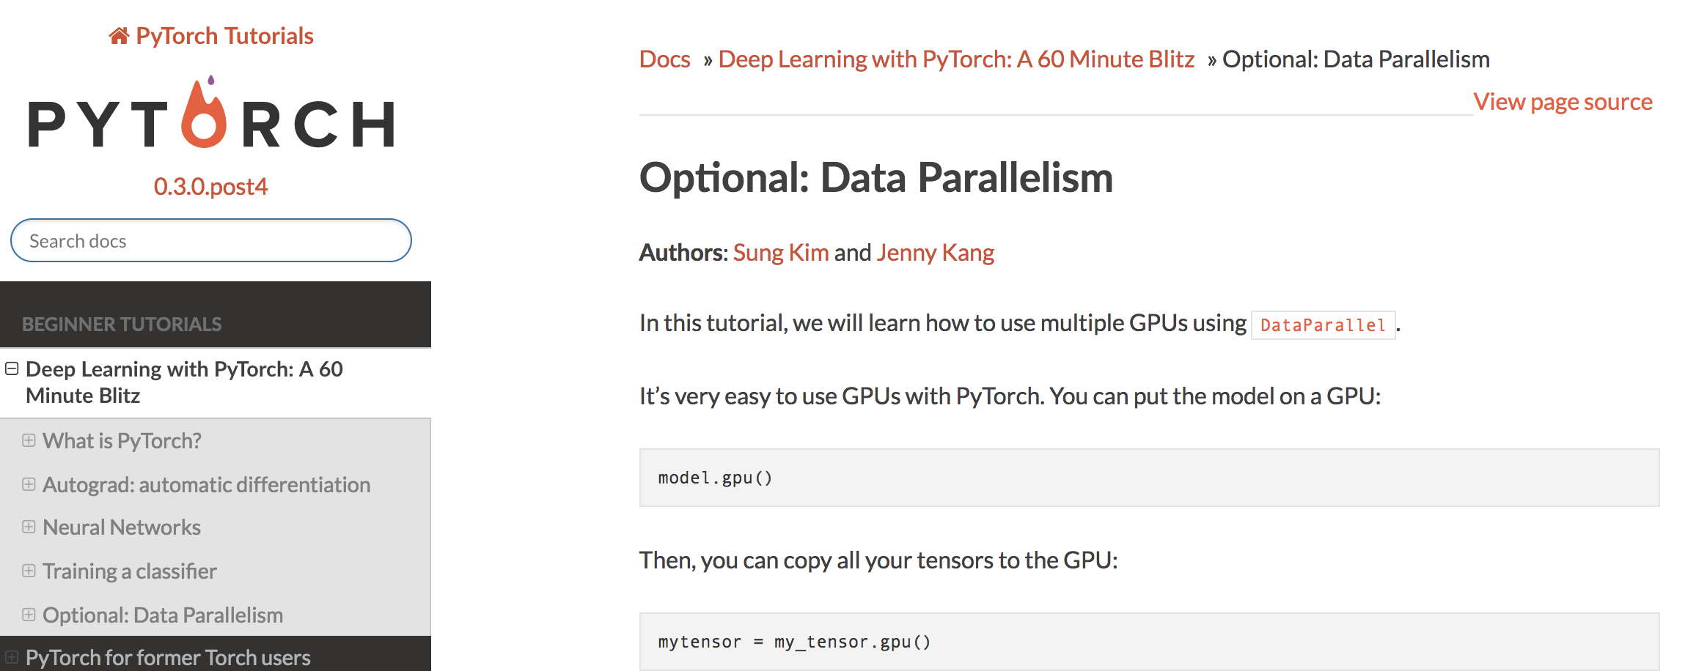
http://pytorch.org/tutorials/beginner/blitz/data_parallel_tutorial.html#sphx-glr-beginner-blitz-data-parallel-tutorial-py

Slide 31
Exercise 13-1: Implement the full name classification
With GPU
With data parallel
Use pad-pack

Slide 32
Exercise 13-2: Sentiment analysis on movie reviews
The sentiment labels are: 0 - negative 1 - somewhat negative 2 - neutral 3 - somewhat positive 4 - positive
https://www.kaggle.com/c/sentiment-analysis-on-movie-reviews/data

Slide 33


Lecture 14:
Language modeling

Slide 34
ML/DL for Everyone with
Lecture 14: RNN III (language modeling)
Sung Kim <hunkim+ml@gmail.com> HKUST
Code: https://github.com/hunkim/PyTorchZeroToAll
Slides: http://bit.ly/PyTorchZeroAll

Slide 35
(Character level) Language Modeling
h
hi

Slide 36
(Character level) Language Modeling
hi
hi!

Slide 37
(Character level) Language Modeling
hi! This is sun
hi! This is sung

Slide 38
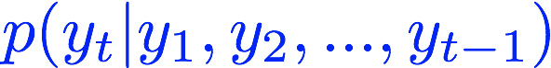
(Character level) Language Modeling
hi! This is sun
hi! This is sung

Slide 39
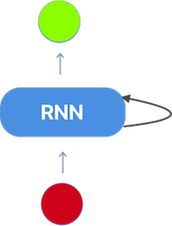
Language Modeling using RNN
def generate(decoder, prime_str='A', predict_len=100, temperature=0.8):
hidden = decoder.init_hidden()
prime_input = str2tensor(prime_str)
predicted = prime_str
# Use priming string to "build up" hidden state
for p in range(len(prime_str) - 1):
_, hidden = decoder(prime_input[p], hidden)
inp = prime_input[-1]
for p in range(predict_len):
output, hidden = decoder(inp, hidden)
# Sample from the network as a multinomial distribution
output_dist = output.data.view(-1).div(temperature).exp()
top_i = torch.multinomial(output_dist, 1)[0]
# Add predicted character to string and use as next input
predicted_char = chr(top_i)
predicted += predicted_char
inp = str2tensor(predicted_char)
return predicted
i! This is sung
decoder
hi! This is sun

Slide 40
Training
def train_teacher_forching(line):
input = str2tensor(line[:-1])
target = str2tensor(line[1:])
hidden = RNNdecoder.init_hidden()
loss = 0
for c in range(len(input)):
output, hidden = decoder(input[c], hidden)
loss += criterion(output, target[c])
decoder.zero_grad()
loss.backward()
decoder_optimizer.step()
return loss.data[0] / len(input)
i! This is sung
decoder
hi! This is sun

Slide 41
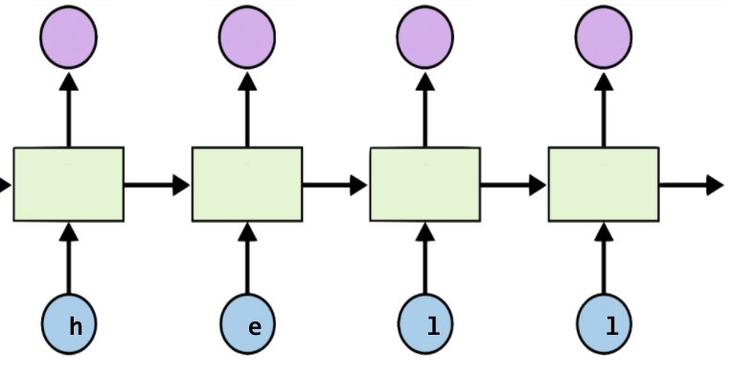
Teacher Forcing
def train_teacher_forching(line):
input = str2tensor(line[:-1])
target = str2tensor(line[1:])
hidden = RNNdecoder.init_hidden()
loss = 0
for c in range(len(input)):
output, hidden = decoder(input[c], hidden)
loss += criterion(output, target[c])
decoder.zero_grad()
loss.backward()
decoder_optimizer.step()
return loss.data[0] / len(input)
Teacher Forcing
https://www.quora.com/What-is-the-teacher-forcing-in-RNN

Slide 42
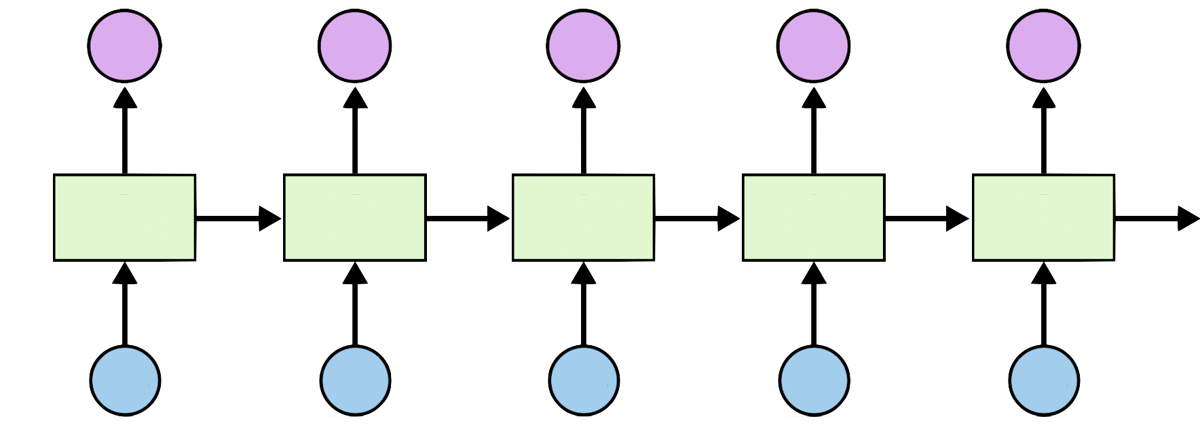
Teacher Forcing
y₁
y_{t}
h_{t}
x₁ = 0
x₂ = y₁
y_{t-1}
Teacher Forcing
No Teacher Forcing (more natural)
https://www.quora.com/What-is-the-teacher-forcing-in-RNN

Slide 43
Training: no teacher forcing
def train(line):
input = str2tensor(line[:-1])
target = str2tensor(line[1:])
hidden = decoder.init_hidden()
decoder_in = input[0]
loss = 0
for c in range(len(input)):
output, hidden = decoder(decoder_in, hidden)
loss += criterion(output, target[c])
decoder_in = output.max(1)[1]
decoder.zero_grad()
loss.backward()
decoder_optimizer.step()
return loss.data[0] / len(input)
y₁
y_{t}
h_{t}
x₁ = 0
x₂ = y₁
y_{t-1}

Slide 44
Data preparation and implementation details
https://github.com/hunkim/PyTorchZeroToAll

Slide 45

Exercise 14-1: Language model with Obama speech
http://obamaspeeches.com/

Slide 46
Lecture 14:
Sequence to Sequence

